Slide 1




prioritizr Systematic conservation planning in R R
Session 1
Jeffrey Hanson
jeffrey.hanson@uqconnect.edu.au
prioritizr.net

Slide 2
Now
Biodiversity
Status quo
2000
Future

Slide 3
Now
How do we
get here?
Biodiversity
Status quo
2000
Future

Slide 4
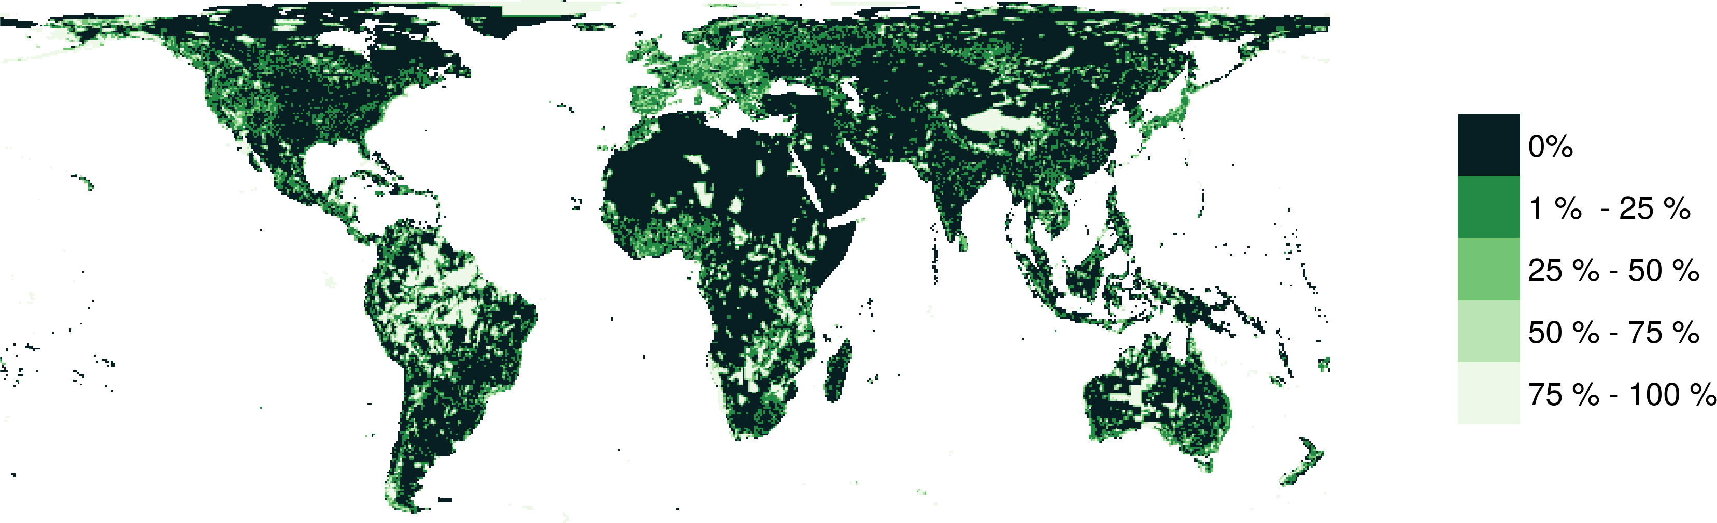
Protected areas

Slide 5



Observations
Statistical models
Priority areas
Biodiversity
2000
Future
Data
Information
Plan
Outcome
Objectives
Constraints

Slide 6
Observations
Statistical models
Priority areas
Biodiversity
2000
Future
Data
Information
Plan
Outcome
Better
plan
Better
outcome
Objectives
Constraints

Slide 7
Reserve selection
Planning units
Discrete places for conservation management
Each planning unit is managed separately
Commonly include land parcels, islands, spatial grid cells
Notes:
- not all remaining habitat can be preserved
- achieve conservation objectives for minimal cost
- modern systematic conservation planning primarily focusses on representing species
- however, this ignores intra-specific biodiversity

Slide 8





Reserve selection
Features
Stuff that we care about
Each feature is relatively independent
Commonly include species, ecosystem types, ecosystem services (e.g., water provisioning, carbon sequestration)
Notes:
- not all remaining habitat can be preserved
- achieve conservation objectives for minimal cost
- modern systematic conservation planning primarily focusses on representing species
- however, this ignores intra-specific biodiversity

Slide 9
Reserve selection
Which planning units should we manage for conservation?
Notes:
- not all remaining habitat can be preserved
- achieve conservation objectives for minimal cost
- modern systematic conservation planning primarily focusses on representing species
- however, this ignores intra-specific biodiversity

Slide 10
CARE Principles
Comprehensive
Adequate
Representative
Efficient
Kukkala & Moilanen (2013) DOI:10.1111/brv.12008

Slide 11


CARE Principles
Comprehensive
Adequate
Representative
Efficient
versus

Slide 12
CARE Principles
Comprehensive
Adequate
Representative
Efficient
versus

Slide 13


CARE Principles
Comprehensive
Adequate
Representative
Efficient
versus

Slide 14

CARE Principles
Comprehensive
Adequate
Representative
Efficient
versus

Slide 15
Connectivity
“improve population resilience to disturbance, increase metapopulation viability, promote genetic diversity and maintain energetic pathways among ecosystems”
Within-reserve connectivity
Daigle et al. (2020) Methods Ecol Evol, DOI:10.1111/2041-210X.13349

Slide 16
Connectivity
“improve population resilience to disturbance, increase metapopulation viability, promote genetic diversity and maintain energetic pathways among ecosystems”
Between-reserve connectivity
Highway
Daigle et al. (2020) Methods Ecol Evol, DOI:10.1111/2041-210X.13349

Slide 17
Principle complementarity
Protected areas should “complement” each other to maximize the performance of the overall protected area network (including. existing protected areas)
Vane-Wright, et al (1991) Biol Cons, DOI: 10.1016/0006-3207(91)90030-D

Slide 18
Reserve selection as optimization
Objective: what do we want to maximize or minimize?
Constraints: what does the prioritization have to do?
Decisions: what will we do to each planning unit?

Slide 19
Minimum set formulation
Objective: min. # of islands
Constraints: ensure adequate coverage of each and every species
Decisions: create a reserve on an island or not?

Slide 21
1
2
3
4
5
6
7
8
9

Slide 22
1
2
3
4
5
6
7
8
9
1
2
3
4
5
6
7
8
9

Slide 23
1
2
3
4
5
6
7
8
9

Slide 24
Upper
1
1
1
1
1
1
1
1
1
Lower
0
0
0
0
0
0
0
0
0
V. type
B
B
B
B
B
B
B
B
B
1
2
3
4
5
6
7
8
9

Slide 25
Min $:
+1
+1
+1
+1
+1
+1
+1
+1
+1
Upper
1
1
1
1
1
1
1
1
1
Lower
0
0
0
0
0
0
0
0
0
V. type
B
B
B
B
B
B
B
B
B
1
2
3
4
5
6
7
8
9

Slide 26
Min $:
+1
+1
+1
+1
+1
+1
+1
+1
+1
1
2
3
4
5
6
7
8
+1
9
+1
Upper
1
1
1
1
1
1
1
1
1
Lower
0
0
0
0
0
0
0
0
0
V. type
B
B
B
B
B
B
B
B
B
1
2
3
4
5
6
7
8
9

Slide 27
Min $:
+1
+1
+1
+1
+1
+1
+1
+1
+1
1
2
3
4
5
6
7
8
+1
9
+1
+1
Upper
1
1
1
1
1
1
1
1
1
Lower
0
0
0
0
0
0
0
0
0
V. type
B
B
B
B
B
B
B
B
B
1
2
3
4
5
6
7
8
9

Slide 28
Min $:
+1
+1
+1
+1
+1
+1
+1
+1
+1
+1
1
2
3
4
5
6
+1
7
8
+1
9
+1
+1
Upper
1
1
1
1
1
1
1
1
1
Lower
0
0
0
0
0
0
0
0
0
V. type
B
B
B
B
B
B
B
B
B
1
2
3
4
5
6
7
8
9

Slide 29
Min $:
+1
+1
+1
+1
+1
+1
+1
+1
+1
+1
+1
+1
+1
+1
+1
+1
+1
+1
+1
+1
+1
Upper
1
1
1
1
1
1
1
1
1
Lower
0
0
0
0
0
0
0
0
0
V. type
B
B
B
B
B
B
B
B
B
1
2
3
4
5
6
7
8
9

Slide 30
Min $:
+1
+1
+1
+1
+1
+1
+1
+1
+1
+1
≥ 1
+1
+1
≥ 1
+1
+1
≥ 1
+1
≥ 1
+1
+1
+1
+1
+1
+1
≥ 1
Upper
1
1
1
1
1
1
1
1
1
Lower
0
0
0
0
0
0
0
0
0
V. type
B
B
B
B
B
B
B
B
B
1
2
3
4
5
6
7
8
9

Slide 31



Min $:
+1
+1
+1
+1
+1
+1
+1
+1
+1
+1
≥ 1
+1
+1
≥ 1
+1
+1
≥ 1
+1
≥ 1
+1
+1
+1
+1
+1
+1
≥ 1
Upper
1
1
1
1
1
1
1
1
1
Lower
0
0
0
0
0
0
0
0
0
V. type
B
B
B
B
B
B
B
B
B
1
2
3
4
5
6
7
8
9

Slide 32
Min $:
+1
+1
+1
+1
+1
+1
+1
+1
+1
+1
≥ 1
+1
+1
≥ 1
+1
+1
≥ 1
+1
≥ 1
+1
+1
+1
+1
+1
+1
≥ 1
Upper
1
1
1
1
1
1
1
1
1
Lower
0
0
0
0
0
0
0
0
0
V. type
B
B
B
B
B
B
B
B
B
1
2
3
4
5
6
7
8
9

Slide 33
1
2
3
4
5
6
7
8
9
1
2
3
4
5
6
7
8
9

Slide 34
But reality is
more complex…

Slide 35
Accounting for existing conservation areas
Min $:
+1
+1
+1
+1
+1
+1
+1
+1
+1
+1
≥ 1
+1
+1
≥ 1
+1
+1
≥ 1
+1
≥ 1
+1
+1
+1
+1
+1
+1
≥ 1
Upper
1
1
1
1
1
1
1
1
1
Lower
0
1
0
0
0
0
1
0
0
V. type
B
B
B
B
B
B
B
B
B
1
2
3
4
5
6
7
8
9

Slide 36
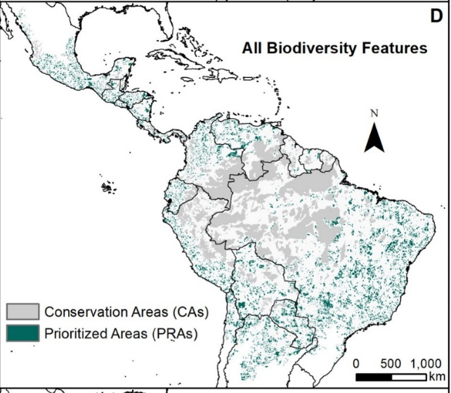
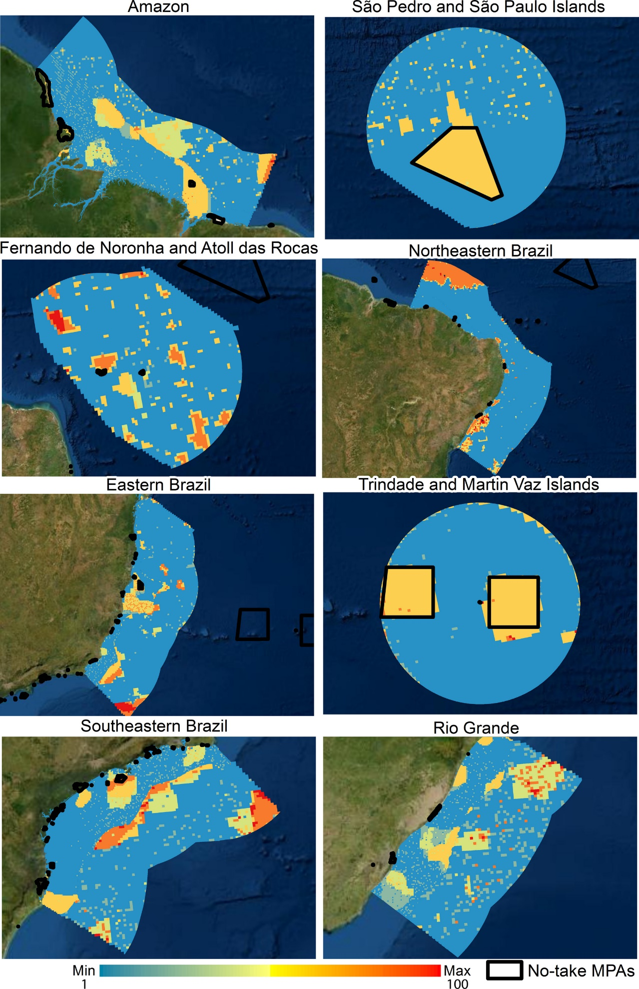
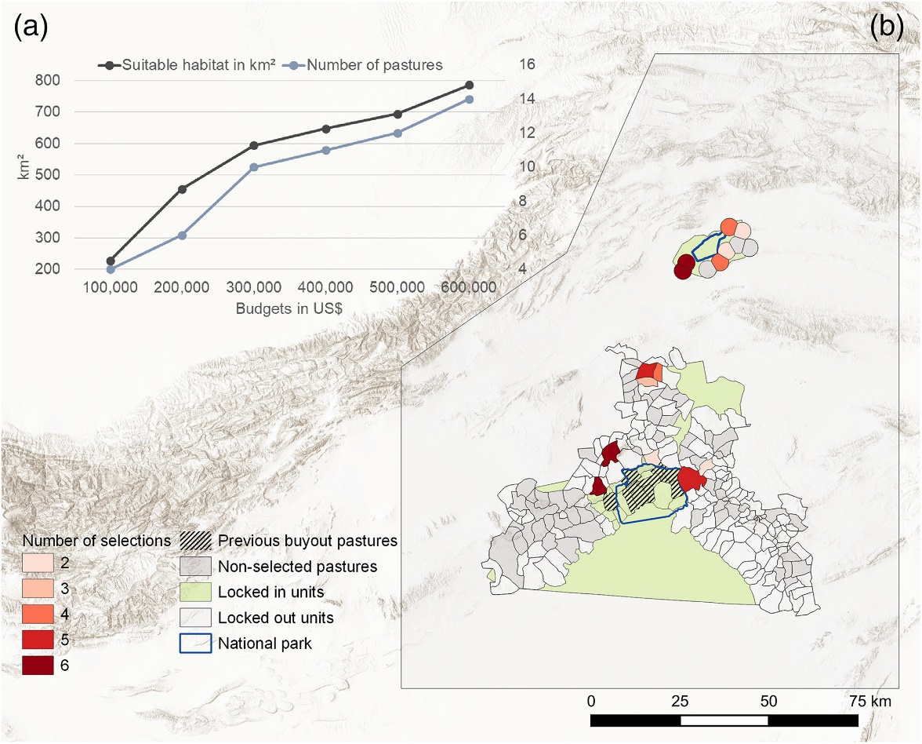

Accounting for existing conservation areas
Protected areas +
Indigenous Lands
No-take marine reserves
Areas with existing habitat + pastures where grazing rights have already been bought
Burbano-Girón et al. (2022)
DOI:10.1016/j.biocon.2021.109421
Magris et al. (2020)
DOI:10.1111/ddi.13183
Daberger et al. (2022)
10.1111/csp2.12832

Slide 37
Accounting for efficiency
Min $:
+9
+2
+5
+1
+5
+8
+3
+6
+8
+1
≥ 1
+1
+1
≥ 1
+1
+1
≥ 1
+1
≥ 1
+1
+1
+1
+1
+1
+1
≥ 1
Upper
1
1
1
1
1
1
1
1
1
Lower
0
1
0
0
0
0
1
0
0
V. type
B
B
B
B
B
B
B
B
B
1
2
3
4
5
6
7
8
9

Slide 38
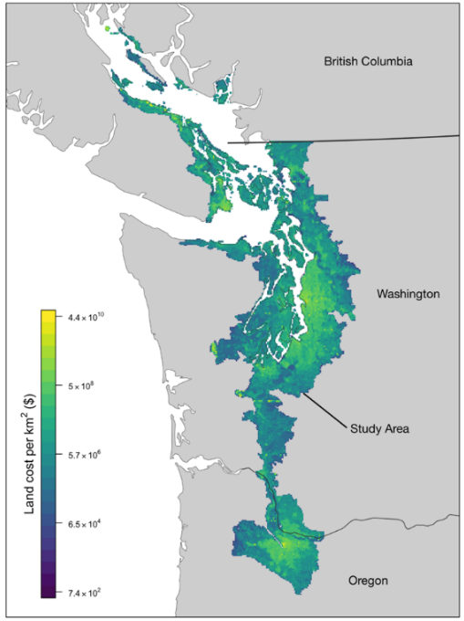
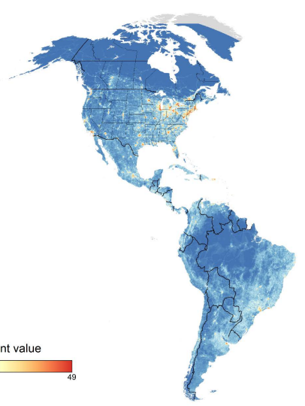
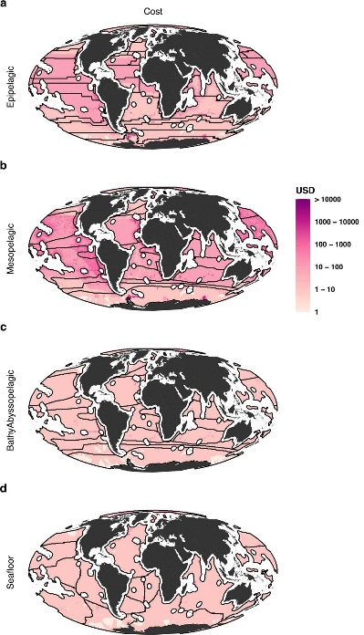
Accounting for efficiency
Land value assessments
Human pressure
Opportunity cost to commercial fisheries
Rodewald et al. (2019)
DOI:10.1038/s41598-019-52241-2
Schuster et al. (2019)
DOI:10.1038/s41467-019-09723-8
Brito-Morales et al. (2022)
DOI:10.1038/s41558-022-01323-7

Slide 39
Accounting for adequacy, comprehensiveness, and representativeness
Min $:
+9
+2
+5
+1
+5
+8
+3
+6
+8
+10
≥ 10
+2
+5
≥ 7
+3
+7
≥ 3
+1
≥ 1
+9
+8
+9
+8
+4
+3
≥ 12
Upper
1
1
1
1
1
1
1
1
1
Lower
0
1
0
0
0
0
1
0
0
V. type
B
B
B
B
B
B
B
B
B
1
2
3
4
5
6
7
8
9

Slide 40
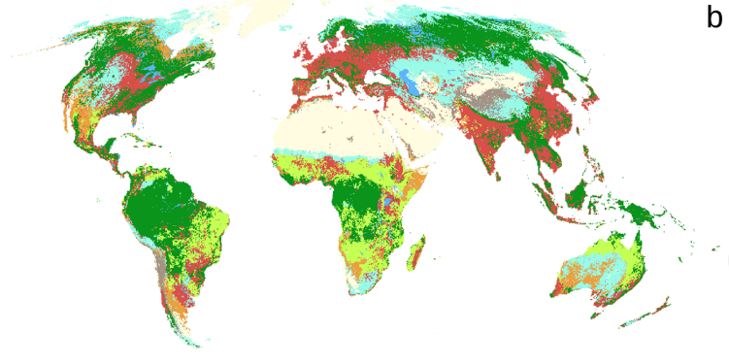
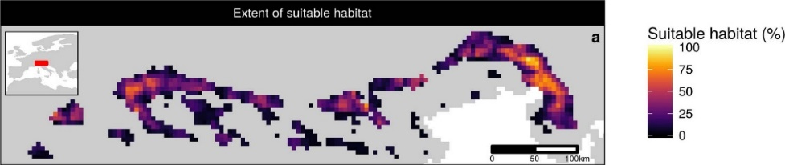
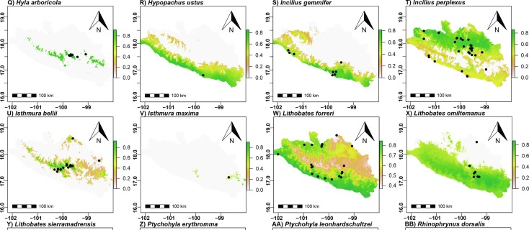
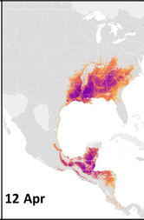
Accounting for adequacy – get good data!
Area of habitat data
Hanson et al. (2022) DOI:10.1038/s41586-020-2138-7
Habitat classification
Jung et al. (2020) DOI: 10.1038/s41597-020-00599-8
Modelled abundance
Fink (2020) DOI:10.1002/eap.2056
Species distribution models
González-Fernández (2022) DOI:10.1016/j.jnc.2022.126235

Slide 41
Accounting for adequacy – set good targets!
Minimum coverage of features by the prioritization
Policy “As a habitat-specific target, we used 17% of the total number of PUs where the respective habitat occurs, adopting Aichi target 11”
Friedrichs et al. (2018) Plos ONE, DOI:10.1371/journal.pone.0208264
Taylor et al. (2017) Plos ONE, DOI:10.1371/journal.pone.0169629
Jung et al. (2021) Nat Ecol Evol DO:10.1038/s41559-021-01528-7

Slide 42
Representation targets
Minimum coverage of features by the prioritization
Policy “As a habitat-specific target, we used 17% of the total number of PUs where the respective habitat occurs, adopting Aichi target 11”
Statistical models “We modelled […] scenarios based on […] the [population viability analysis] by Todd et al. (2016). The reserve scenarios were based on the protected area required to achieve a less than 5% chance of the Leadbeater’s Possum population falling to (or below) 500 or fewer adult females in 40 generations ”
Friedrichs et al. (2018) Plos ONE, DOI:10.1371/journal.pone.0208264
Taylor et al. (2017) Plos ONE, DOI:10.1371/journal.pone.0169629
Jung et al. (2021) Nat Ecol Evol DO:10.1038/s41559-021-01528-7

Slide 43
Representation targets
Minimum coverage of features by the prioritization
Policy “As a habitat-specific target, we used 17% of the total number of PUs where the respective habitat occurs, adopting Aichi target 11”
Statistical models “We modelled […] scenarios based on […] the [population viability analysis] by Todd et al. (2016). The reserve scenarios were based on the protected area required to achieve a less than 5% chance of the Leadbeater’s Possum population falling to (or below) 500 or fewer adult females in 40 generations ”
Export thresholds “We set species targets to conserving the minimum amount of species’ habitat necessary to qualify it for the conservation status ‘Least Concern’ following IUCN Red List criteria”
Friedrichs et al. (2018) Plos ONE, DOI:10.1371/journal.pone.0208264
Taylor et al. (2017) Plos ONE, DOI:10.1371/journal.pone.0169629
Jung et al. (2021) Nat Ecol Evol DO:10.1038/s41559-021-01528-7

Slide 44
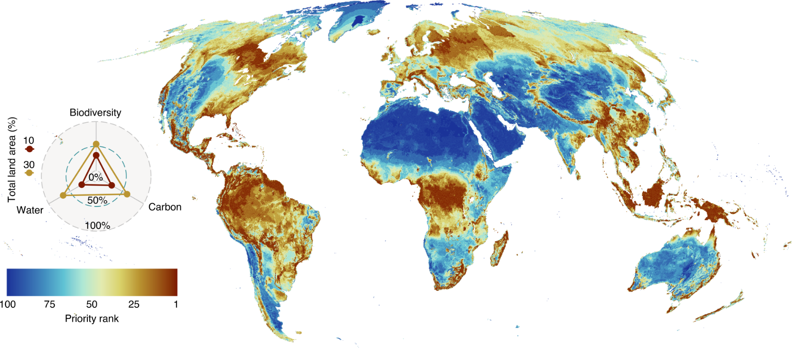
Accounting for comprehensiveness
Amphibians, mammals, birds, reptiles, plants, water provisioning, carbon sequestration
Jung et al. 2021 DOI:10.1038/s41559-021-01528-7

Slide 45
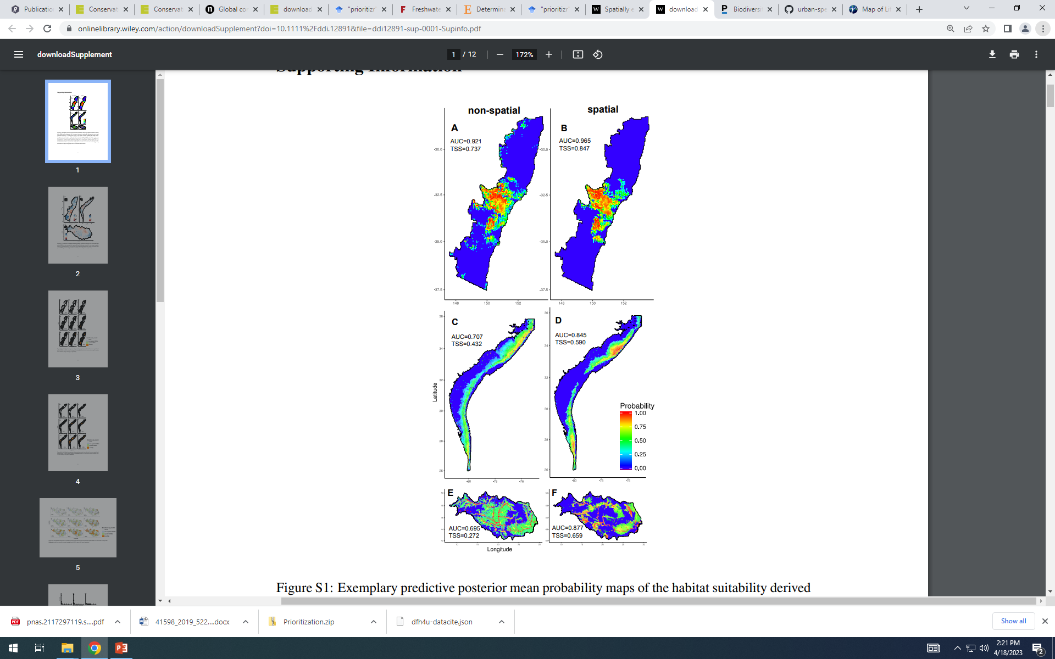
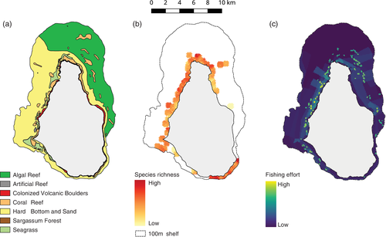
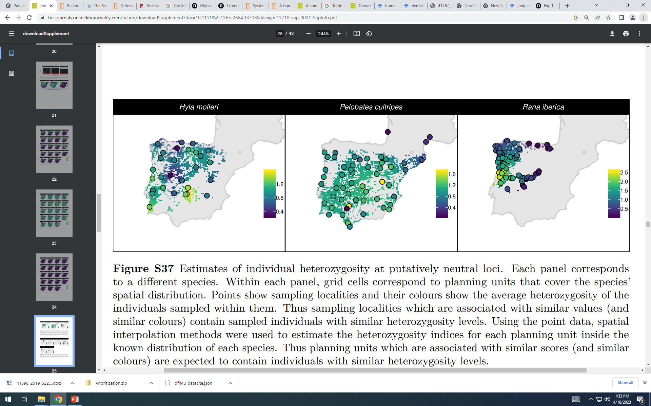
Accounting for representativeness
Species
Ecosystems
Genes
Hanson et al. (2022)
DOI: 10.1111/1365-2664.13718
Flower et al. (2010)
DOI: 10.1111/csp2.158
Domisch et al. (2019)
DOI: 10.1111/ddi.12891

Slide 46
Accounting for connectivity
Min $:
+9
+2
+5
+1
+5
+8
+3
+6
+8
+10
≥ 10
+2
+5
≥ 7
+3
+7
≥ 3
+1
≥ 1
+9
+8
+9
+8
+4
+3
≥ 12
Upper
1
1
1
0
1
1
1
1
0
Lower
0
1
0
0
0
0
1
0
0
V. type
B
B
B
B
B
B
B
B
B
1
2
3
4
5
6
7
8
9

Slide 47
What if connectivity = 1/distance?
Min $:
+9
+2
-3*1/5
Let’s just consider islands 1 and 2
-1
+1
≤ 0
+1
-1
1
2
≤ 0
-1
-1
+1
≥ -1
5 km
Upper
1
1
1
Lower
0
1
0
V. type
B
B
B
1
2
1&2
Scaling factor: 3 connectivity units = 1 cost unit
Beyer et al. (2016)
DOI:10.1016/j.ecolmodel.2016.02.005

Slide 48
What if connectivity = 1/distance?
Min $:
+9
+2
-3*1/5
Let’s just consider islands 1 and 2
(1)
-1
+1
≤ 0
1
(2)
+1
-1
≤ 0
1
2
-1
-1
+1
≥ -1
5 km
Upper
1
1
1
Lower
0
1
0
V. type
B
B
B
1
2
1&2
So, +1 variable and +2 constraints per pair of planning units.. increases problem size a lot!
E.g., 1k planning =
~500k extra constraints

Slide 49
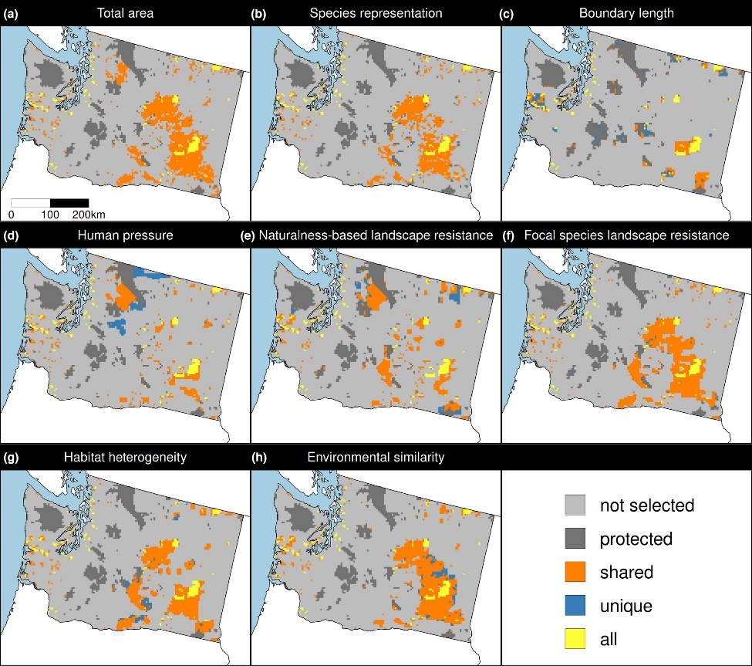
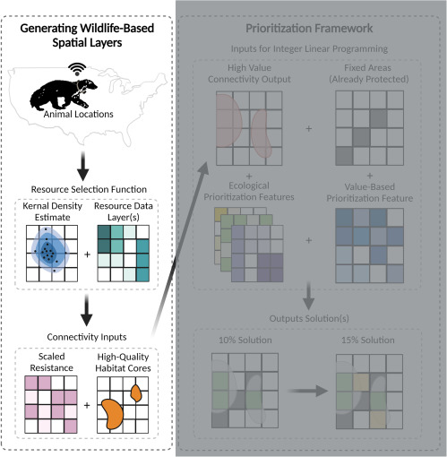
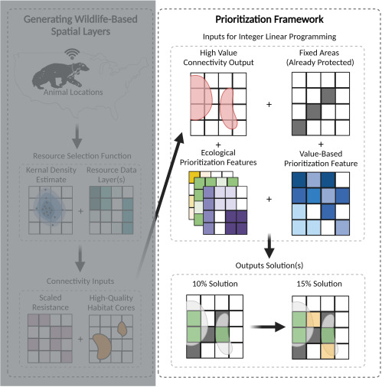
Accounting for connectivity
Carroll (2021)
DOI:10.1016/j.xpro.2021.100882
Hanson et al. (2022) DOI:10.1111/1365-2664.14251

Slide 50
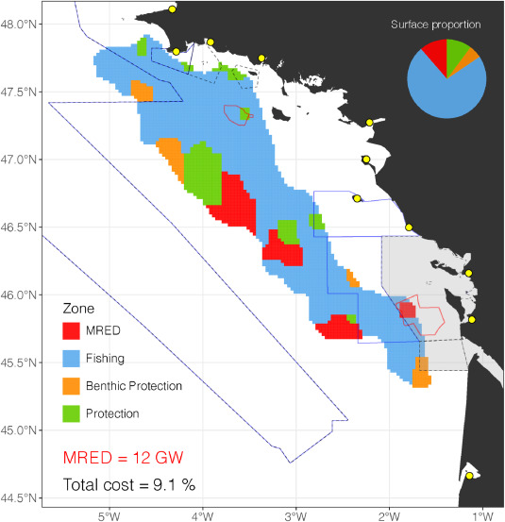
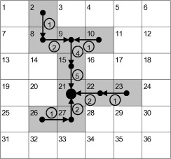
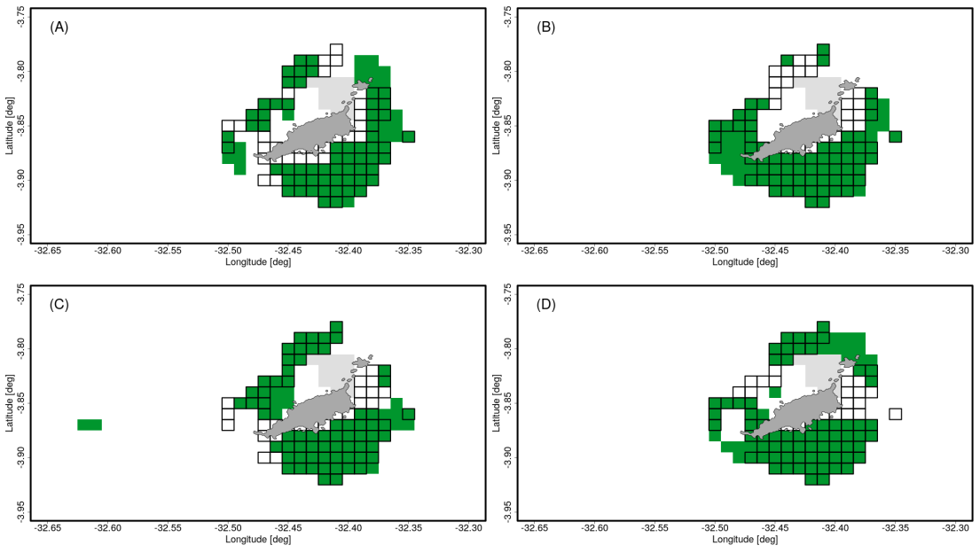
Other stuff too!
Solution portfolios
Spatially contiguity
Brunel et al. (2022)
DOI: 10.1007/s10666-022-09862-1
Wang and Önal (2013)
DOI: 10.1016/j.chnaes.2013.07.004
Multiple management zones
Boussarie et al. (2023)
DOI: 10.1016/j.jenvman.2023.117857

Slide 51
What you will do today
Workshop manual sections 1—4.
Learn how to work with spatial data in R
Perform a gap analysis
Answer questions in the manual
https://prioritizr.github.io/workshop

Slide 52
Getting help
prioritizr website
https://prioritizr.net
RDocumentation
https://www.rdocumentation.org
Geocompr
https://geocompr.robinlovelace.net/

Slide 53



jeffrey.hanson@uqconnect.edu.au
github.com/prioritizr/prioritizr
prioritizr.net

